Slide 1
Technology Systems
Edmund Martei

Slide 2
Why do we maintain Technology Systems
To prevent faults occurring and/or to repair faults
To upgrade internal/external components
To change the system functionality (network system)
Computer faults are often connected to errors, mistakes, defects and failures with some components. Outdated hardware can also cause faults to the system when the clients are running demanding application and there is not enough memory in the ram that can result in errors or the software running slow. Faults vary depending on the hardware technology being maintained as hardware evolves over time.
Notes:
Because the system is used 24/7 the components can overheat, have errors and defects

Slide 3
Benefits of installing computer system
There are a lot of benefits when you install a computer system, here a some :
Reduce cost
Improve performance e.g. efficiency
Improve customer service
The uses of sharing hardware resources for a business that have different offices around the globe is a major advantage it allows them to share files also work on the same files, share information securely within the firm and increasing the productivity. Also Businesses can save money by purchasing one software licence and sharing it with all the computer hardware in the firm.

Slide 4
Uses
Sharing
Sharing hardware resources ( printers, internet, scanner, storage)
File server( expensive)
Communication
(instant messaging, social networking, Blogs)
The uses of sharing hardware resources for a business that have different offices around the globe is a major advantage it allows them to share files also work on the same files, share information securely within the firm and increasing the productivity. Also Businesses can save money by purchasing one software licence and sharing it with all the computer hardware in the firm.
Communication methods like instant messaging and social networking allows firms to hold meeting without having their employees travelling to the meeting location saving the business money.
Businesses can save money on telephone bills if they have all their calls on a social networking like Skype

Slide 5
Features
Level of Access
Security
File management
Device management
Security
Prevent unauthorized access to programs and data by means of password, Firewall and software applications.
File management
Manage the resources and decides who gets the resources
Device management
Keeps track of all devices and decides which process gets the device, when and for how much time
Level of Access
Read only (Users can only read files)
Read and write(Users can read and edit files but they cannot delete it or move it)
Full Control (The User have full control on the files he can edit, write, and delete)

Slide 6
Strengths and weaknesses of computer networks
Strength:
Sharing devices such as printers
Sharing files between users
Security, users cannot see other users files unlike on stand-alone
Backup all the data is stored an a server
Weakness:
Network cabling and file servers can be expensive
If the server breaks down the files on it are inaccessible
Viruses can spread to other computers throughout a computer network

Slide 7
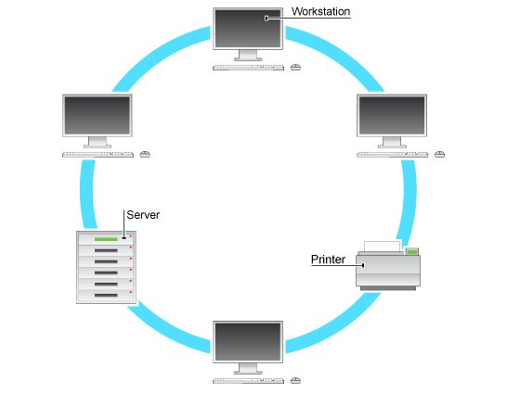
Ring Network
Strength
This type of network can transfer data quickly, even if there are a large number of devices connected because the data only flows in one direction, so there won’t be any data collisions
Weakness
If the main cable fails or any device is faulty then the whole network will fail.
Bus Topology
A bus topology is another type of design where a single cable connects all computers and the information intended for the last node on the network must run through each connected computer. If a cable is broken, all computers connected down the line cannot reach the network. The benefit of a bus topology is a minimal use of cabling.

Slide 8
Star Topology
A star topology is a design of a network where a central node extends a cable to each computer on the network. On a star network, computers are connected independently to the center of the network. If a cable is broken, the other computers can operate without problems. A star topology requires a lot of cabling.
A computer network is a set of connected computers. Computers on a network are called nodes. The connection between computers can be done via cabling, most commonly the Ethernet cable, or wirelessly through radio waves. Connected computers can share resources, like access to the Internet, printers, file servers, and others. A network is a multipurpose connection, which allows a single computer to do more

